Slide 1
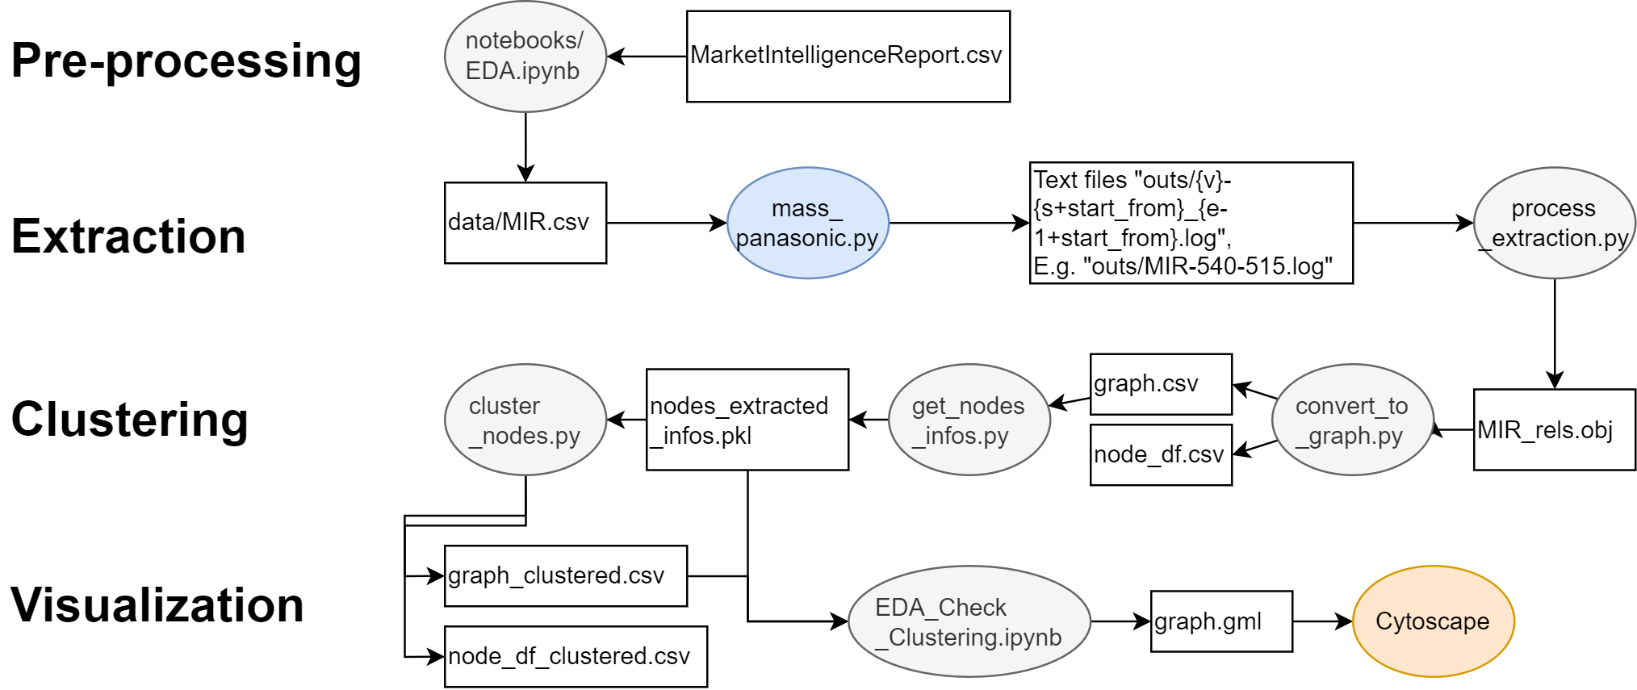

Slide 2
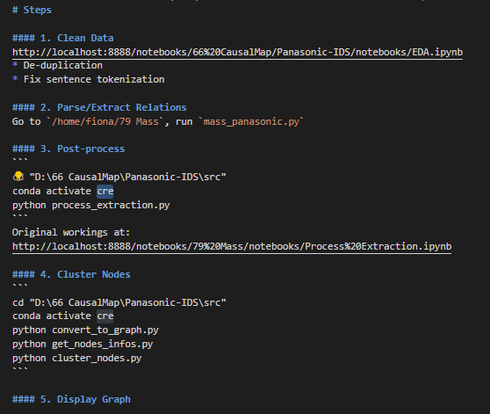
README.md
mass_Panasonic.py is missing
It’s from another repository. I will send a zip file over.
Conda environment setting file ‘cre’ missing
I uploaded the environment yml file to replicate.

Slide 3
Qns:
entire script of `mass_panasonic.py` is missing
This script is under “Mass”, a repository to extract causal relations. I will send a zipped file of this repository over to you.
2. inside 'Evaluate Extraction.ipynb', missing source file of "20230313_MIR_rels.obj", can explain how and which script file / jupyter notebook create this file?
See Figure, after “mass_panasonic.py”. I just renamed the file to save it according to the date I parsed, hence the additional prefix “20230313”.
3. inside 'Summarization for Nodes.ipynb', missing source file of "node_df_spans.csv", can explain how and which script file / jupyter notebook create this file?
These are working files when I was trying alternative methods to represent the nodes. They are somewhat equivalent to “node_df.csv”. You can ignore them, we do not use them in the end.
4. inside 'EDA_Check Extraction.ipynb', missing file of 'MIR-540_554.log', can explain how and which script file / jupyter notebook create this file?
See Figure, after “mass_panasonic.py”, we obtain a folder full of logs.

Slide 4
Suggest you try to replicate from “mass_panasonic.py” onwards first
If we are set on the methodology, can combine the code into one shell script.
Easy since all are “.py” scripts.
Only the “.ipynb” one needs to refactor
Replication of “mass_panasonic.py” itself requires more dependencies, and possibly a GPU access

